Slide 1
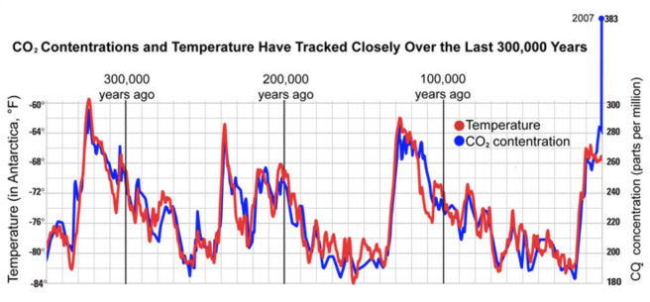
CO2 / Temperature Relationship Over Time

Slide 2
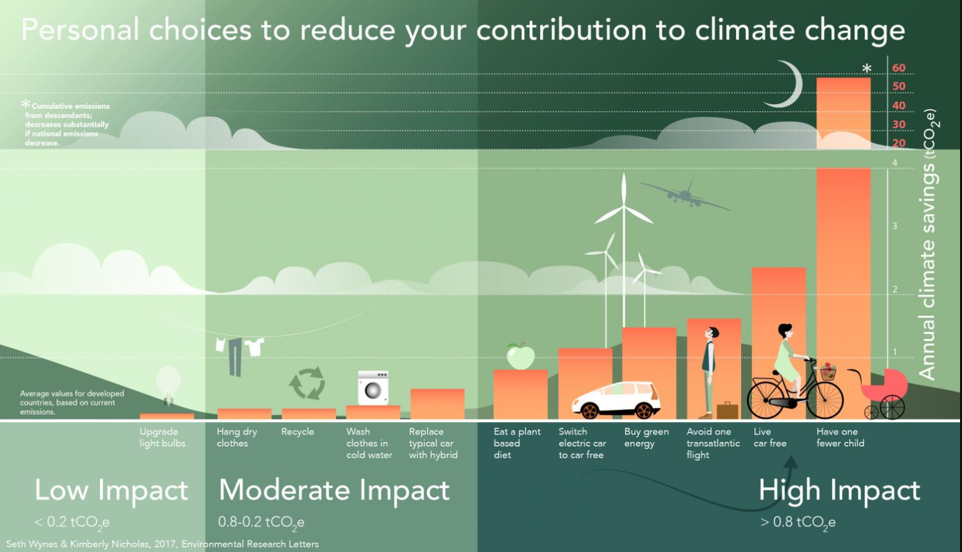

Notes:
GB
There’s a lot of information in this graphic, but coming up are four things that you (or your family) can do to help tackle climate change.

